Slide 1
Real World Polyglot Persistence
Jimmy Bogard
@jbogard
jimmybogard.lostechies.com

Slide 2
What is NoSQL?
Not relational
Built for scale
Typically schemaless

Slide 3
Relational Models

Slide 4
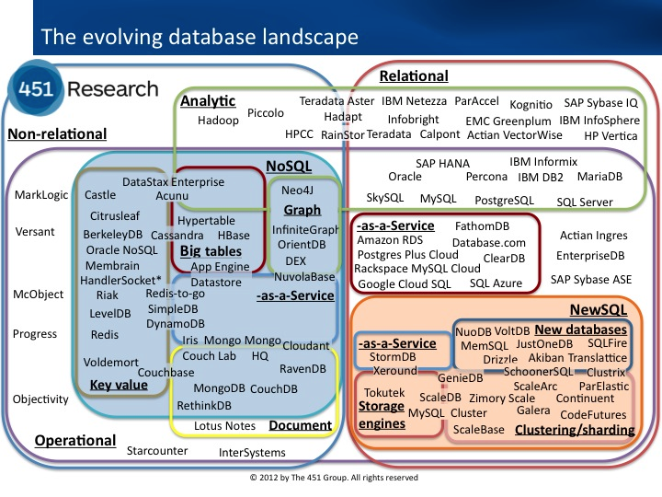
NoSQL Families

Slide 5
Challenges

Slide 6



Availability/support

Slide 7

FUD

Slide 8
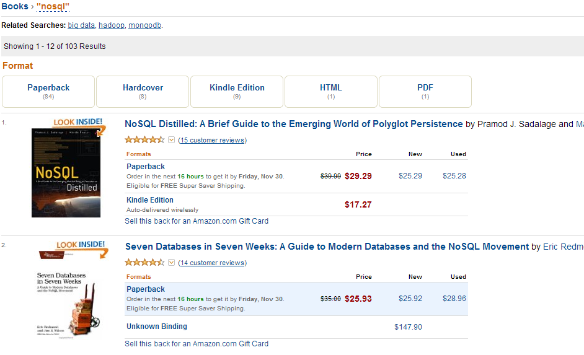
Expertise

Slide 9
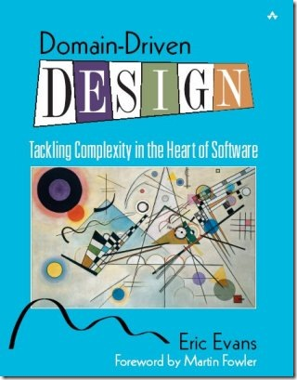
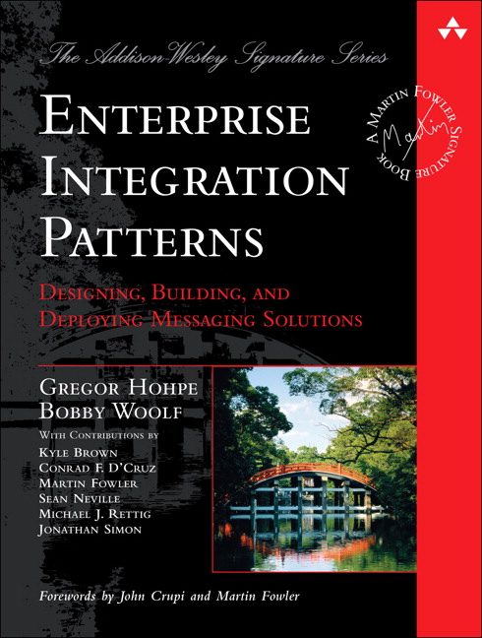
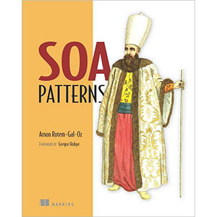
Putting it together

Slide 10
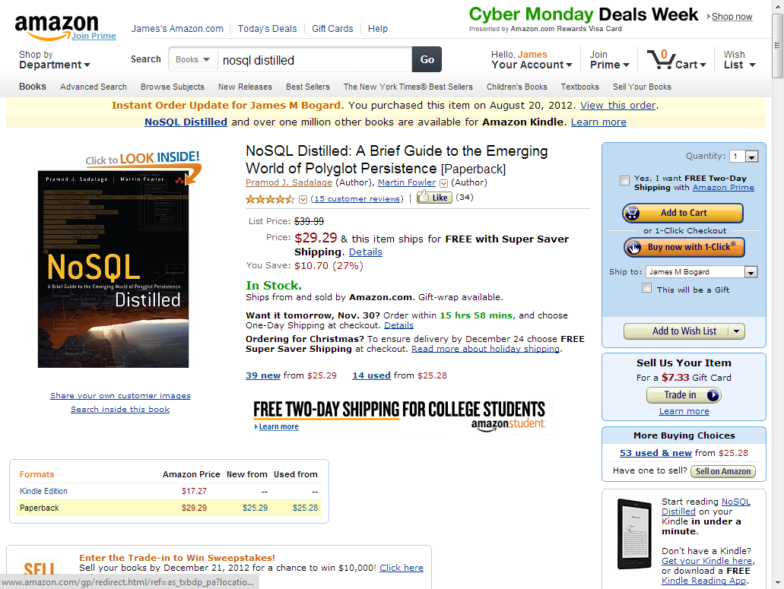
Amazon example

Slide 11
Flipping N-Tier
UI
BL
DAL
DB

Slide 12
Sample App

